Slide 1


K.RAMAKRISHNAN COLLEGE OF TECHNOLOGY (AUTONOMOUS), TRICHY
Creating a Fun Quiz App
Using R and Shiny
PRESENTED BY
GAYATHRI.A-LAM24001
GUIDED BY
Mrs.SANTHOSHINI, AP/AI

Slide 2
PRESENTATION OVERVIEW
Problem Identification
Objective
Dataflow Daigram
List OF Modules
Module Description
Implementation Screenshots
Conclusion

Slide 3
PROBLEM IDENTIFICATION
Traditional quiz methods often fail to engage users effectively.
Manual quiz evaluation lacks real-time feedback capabilities.
Existing R tools do not offer user-friendly, interactive quiz solutions.
Customizing quizzes without programming knowledge is challenging.

Slide 4
OBJECTIVE
The objective of this project is to develop an interactive and engaging quiz application using R and Shiny. It aims to enhance user learning through dynamic question display, real-time feedback, and score tracking.

Slide 5
DATAFLOW DIAGRAM
user Interface (Shiny Frontend)
Question Database
(CSV / RDS File)
Server Logic
(ShinyBackend)
Score Calculation
Result Display

Slide 6
LIST OF MODULES
User Interface Module
Question Management Module
Answer Evaluation Module
Score Tracking Module
Feedback and Result Module
Data Storage Module
2/7/20

Slide 7
MODULES DESCRIPTION
USER INTERFACE MODULE – Builds the quiz layout and allows user interaction.
QUESTION MANAGEMENT MODULE – Loads and displays questions dynamically from data sources.
ANSWER EVALUATION MODULE – Compares user answers with correct ones to check accuracy

Slide 8
MODULES DESCRIPTION
SCORE TRACKING MODULE – Monitors and updates the user’s score during the quiz.
FEEDBACK AND RESULT MODULE – Provides instant feedback and shows final results.
DATA STORAGE MODULE – Handles storage of questions, answers, and user performance data.

Slide 9

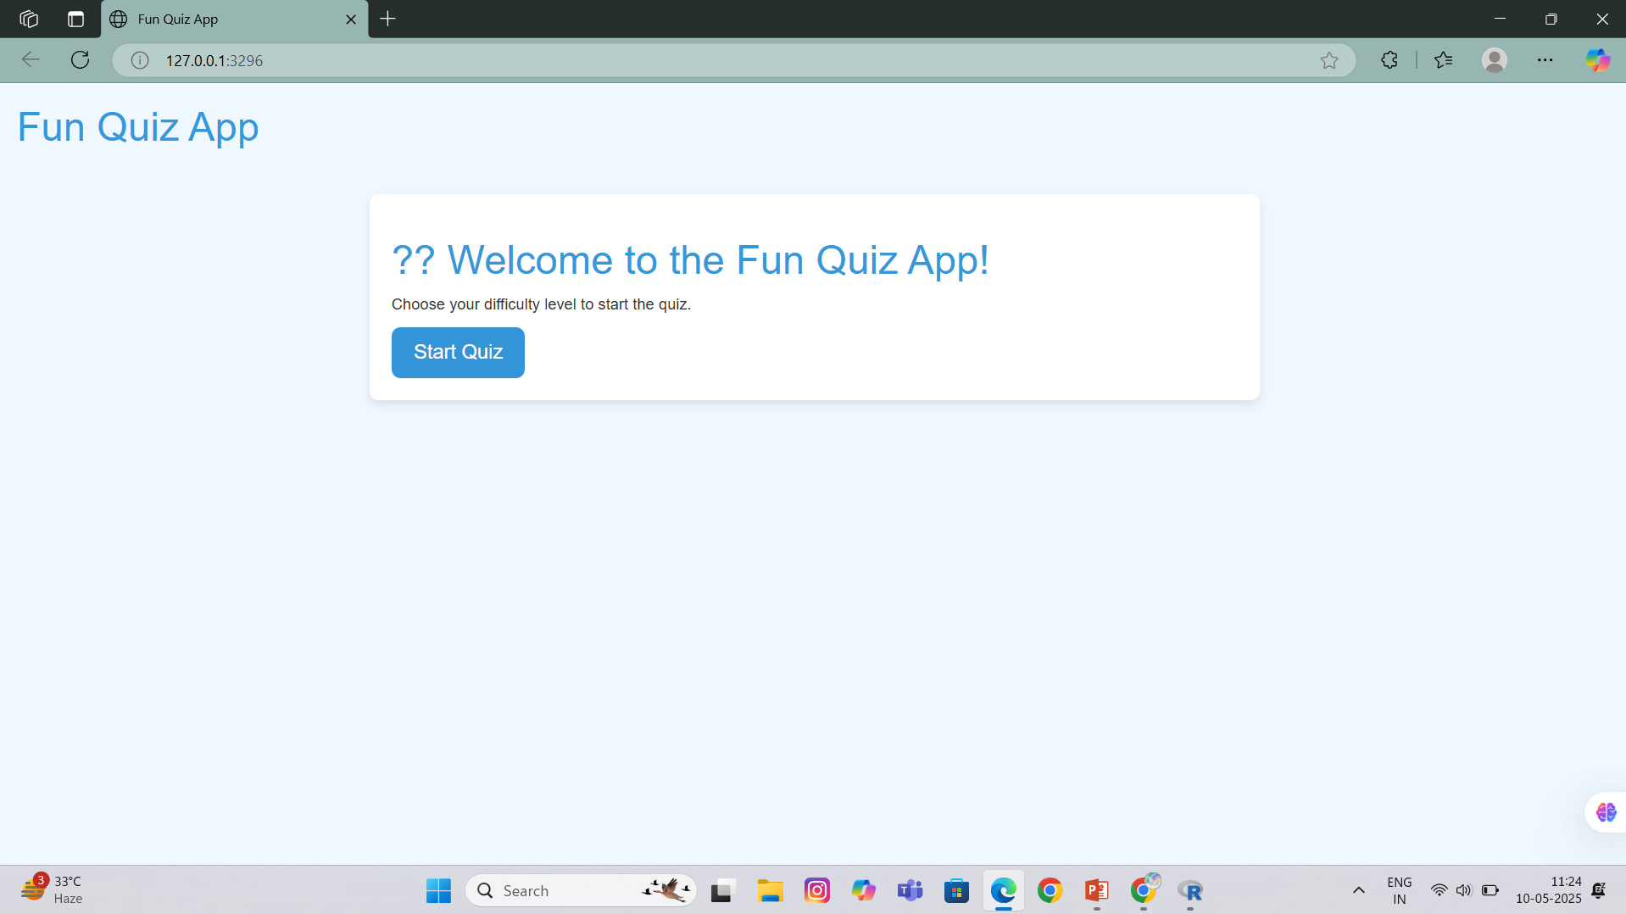
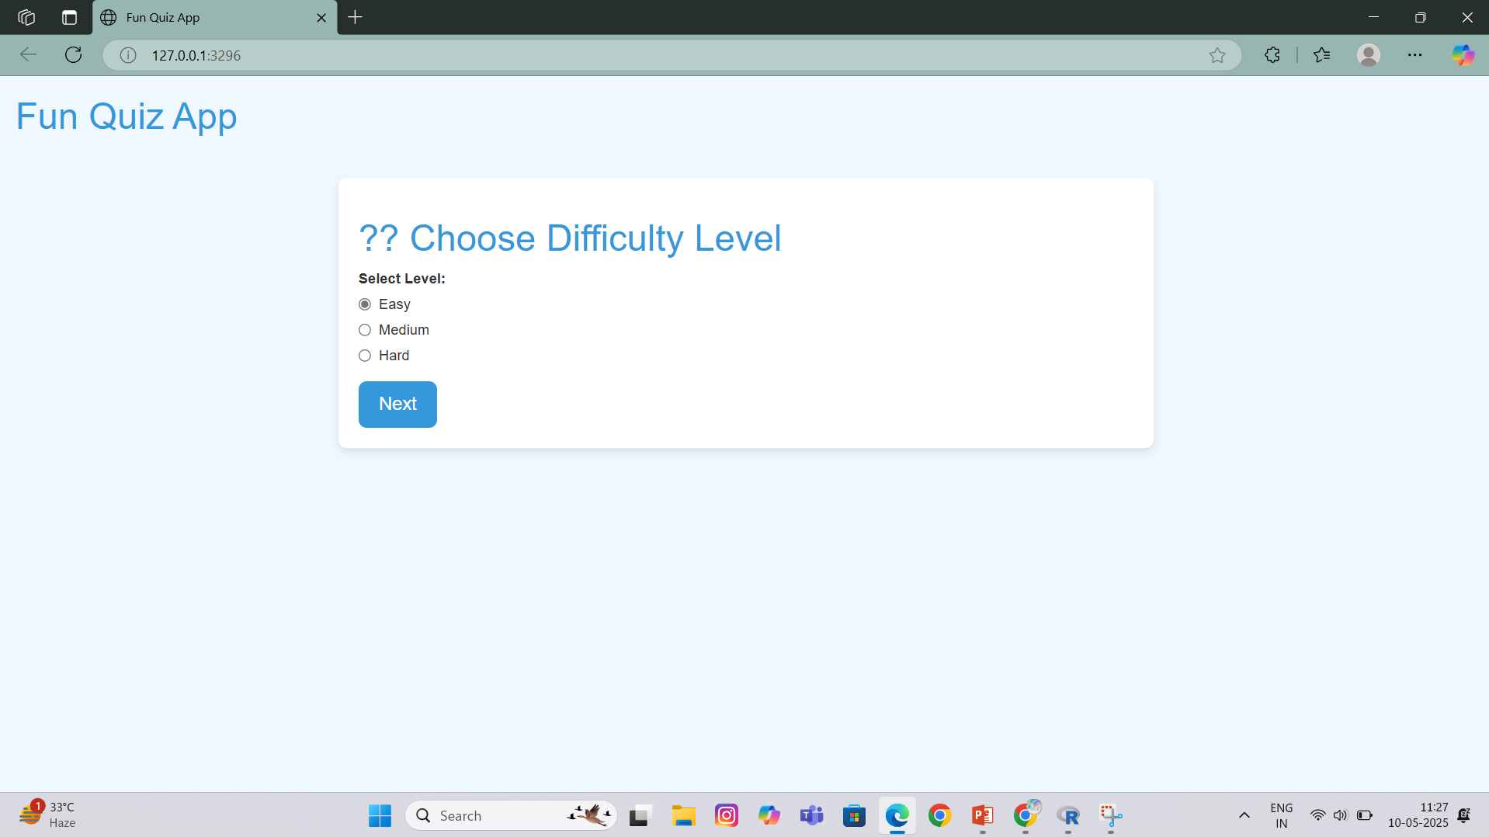

IMPLEMENTATION SCREENSHOTS

Slide 10


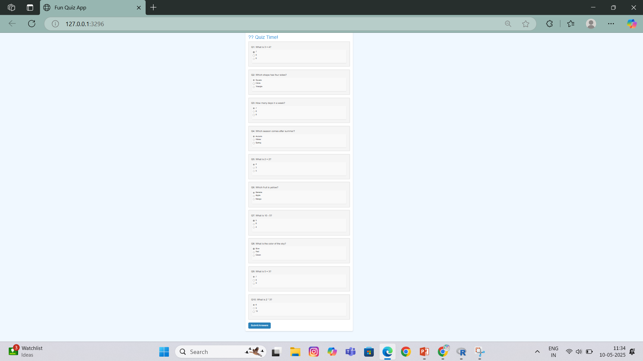
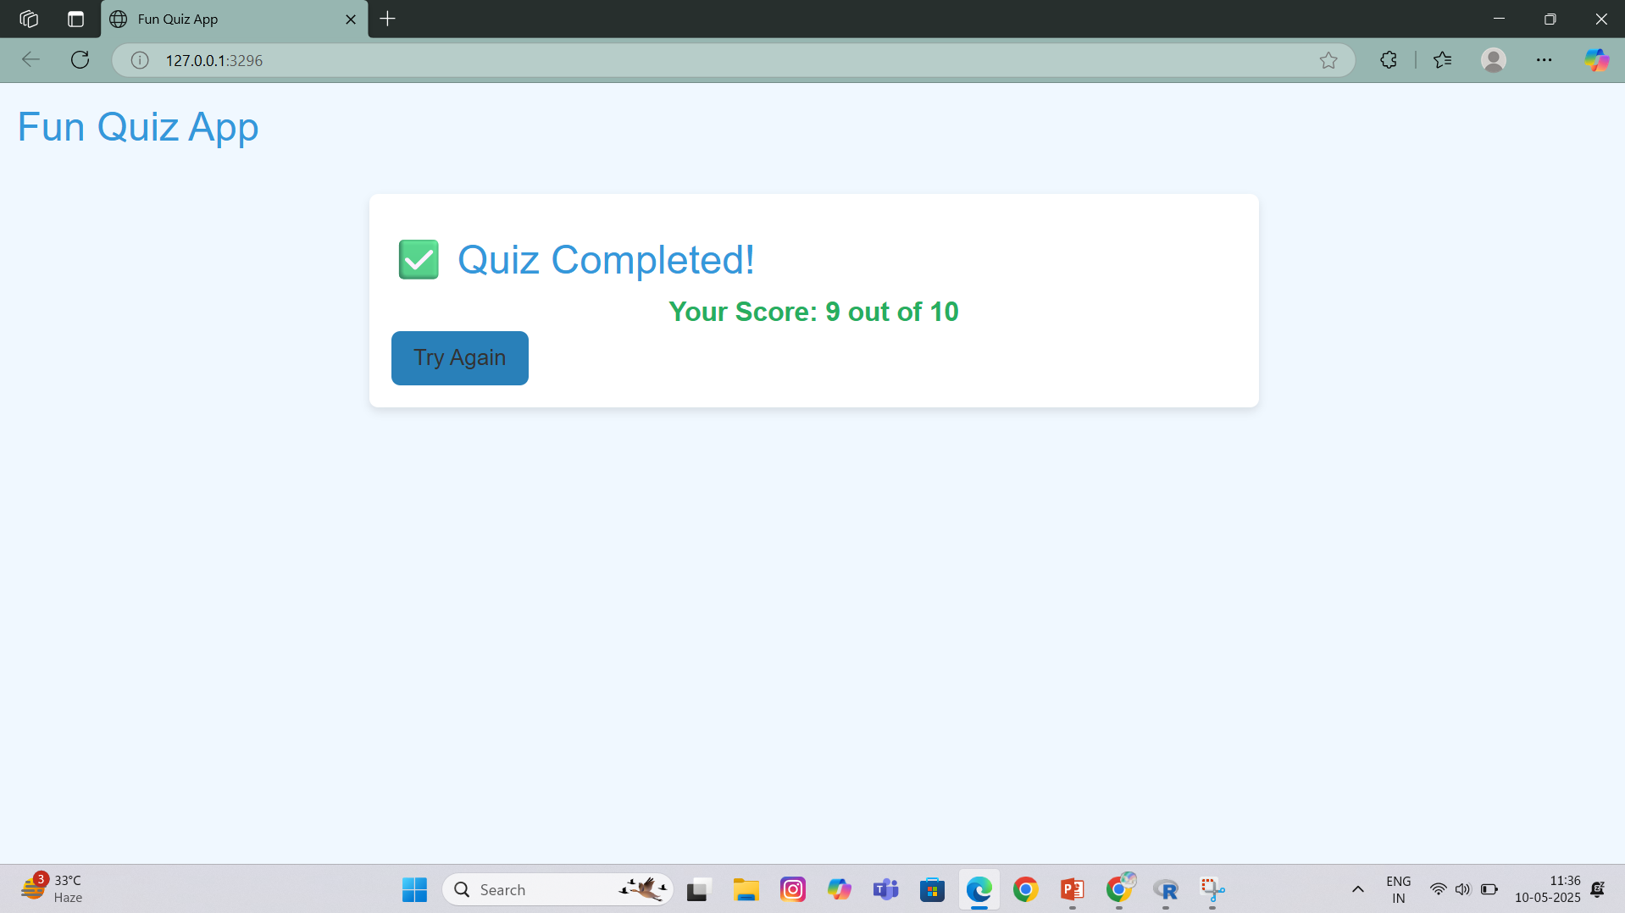
IMPLEMENTATION SCREENSHOTS

Slide 11
CONCLUSION
The Fun Quiz App is an interactive learning tool developed using R and Shiny, designed to make quizzes engaging, dynamic, and educational. It integrates essential modules such as user interface, question management, real-time evaluation, score tracking, and feedback display. This application enhances the learning experience by offering immediate results, easy customization, and a user-friendly platform for both learners and educators.

Slide 12


